Slide 1
Bayesian Inference
Module 2, Lesson 3
Notes:
Welcome to lesson 3 of module 2 of Bayesian Inference

Slide 2
Other Single-Parameter Models
Shahrzad Jamshidi, PhD
Notes:
In this lesson, we will discuss other single parameter models

Slide 3
Last Time
Priors can be informative, noninformative, or weakly informative (a mixture of the two).
Informative priors can be conjugate or not.
We have seen uniform, binomial and beta distributions.
Notes:
Last time, we saw how priors can be informative, noninformative, or weakly informative.
We also discussed conjugate priors, which were analytically nice to work with.
It’s important to note that the distributions we have seen so far are uniform, binomial and beta distributions.

Slide 4
Objective
Explore various standard single-parameter models and their applications.
Normal distribution with unknown mean
Normal distribution with unknown variance
Poisson distribution
Exponential distribution
Notes:
By the end of this lesson, you will have explored various standard single-parameter models and their applications. Specifically, you will know
Normal distribution with unknown mean
Normal distribution with unknown variance
Poisson distribution
Exponential distribution

Slide 5

Topics to Review for This Lesson
Normal Distributions
Scaled Inverse $χ^{2}$ Distributions
Poisson Distributions
Gamma Distributions
Notes:
To help you with this lesson, I recommend you review
Normal distributions
Scaled inverse chi-squared distributions
Poisson distributions
And Gamma distributions.

Slide 6
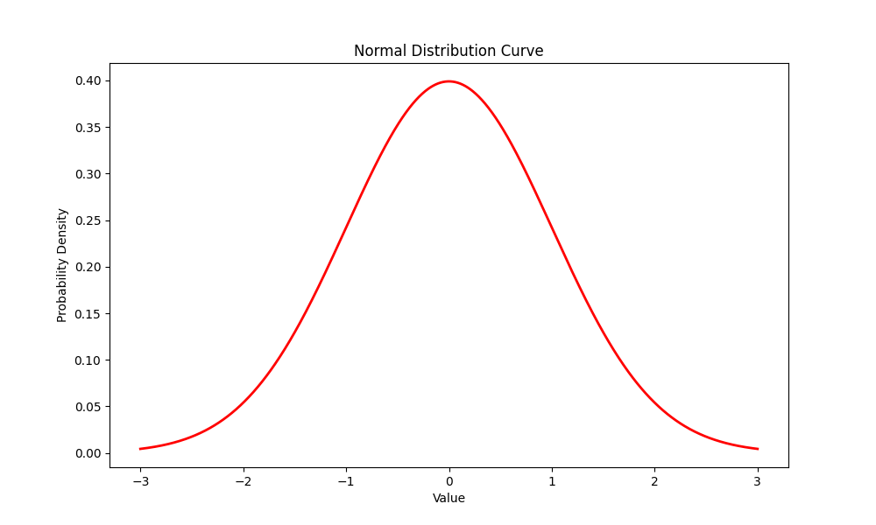
Normal Distribution
The normal distribution is fundamental to statistics.
The central limit theorem
Several kinds of populations
Consider the model as a single-parameter model with respect to the mean.
Notes:
A normal distribution is quite fundamental to statistics—it is the distribution referenced whenever one performs a z-test.
But conceptually, it is important to statistics because of the central limit theorem.
It is important to the sciences in general because several kinds of populations follow a normal distribution.
We can consider a normal distribution as a single parameter model by assuming the mean is unknown.

Slide 7
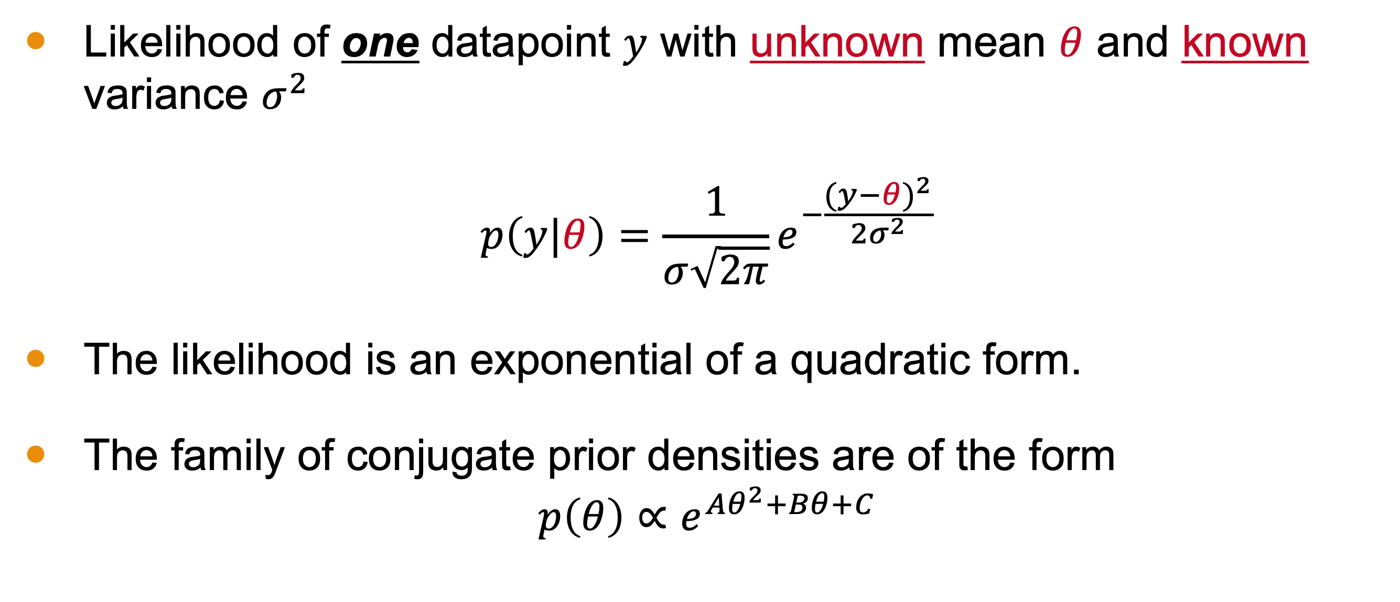
Likelihood and Conjugate Prior Densities
Likelihood of one datapoint $y$ with unknown mean $θ$ and known variance $σ^{2}$
$$p\left(y|θ\right)=\frac{1}{σ\sqrt{2π}}e^{−\frac{{(y−θ)}^{2}}{2σ^{2}}}$$
The likelihood is an exponential of a quadratic form.
The family of conjugate prior densities are of the form
$$p\left(θ\right)∝e^{Aθ^{2}+Bθ+C}$$
Notes:
The normally distributed likelihood of one datapoint y with unknown mean $θ$ and known variance $σ^{2}$
Follows this well-known expression in statistics
Notice that the function form is an exponential of a quadratic.
So we should expect the family of conjugate priors to follow this form

Slide 8
(board example inserted here)
Notes:
Solving for the distribution

Slide 9
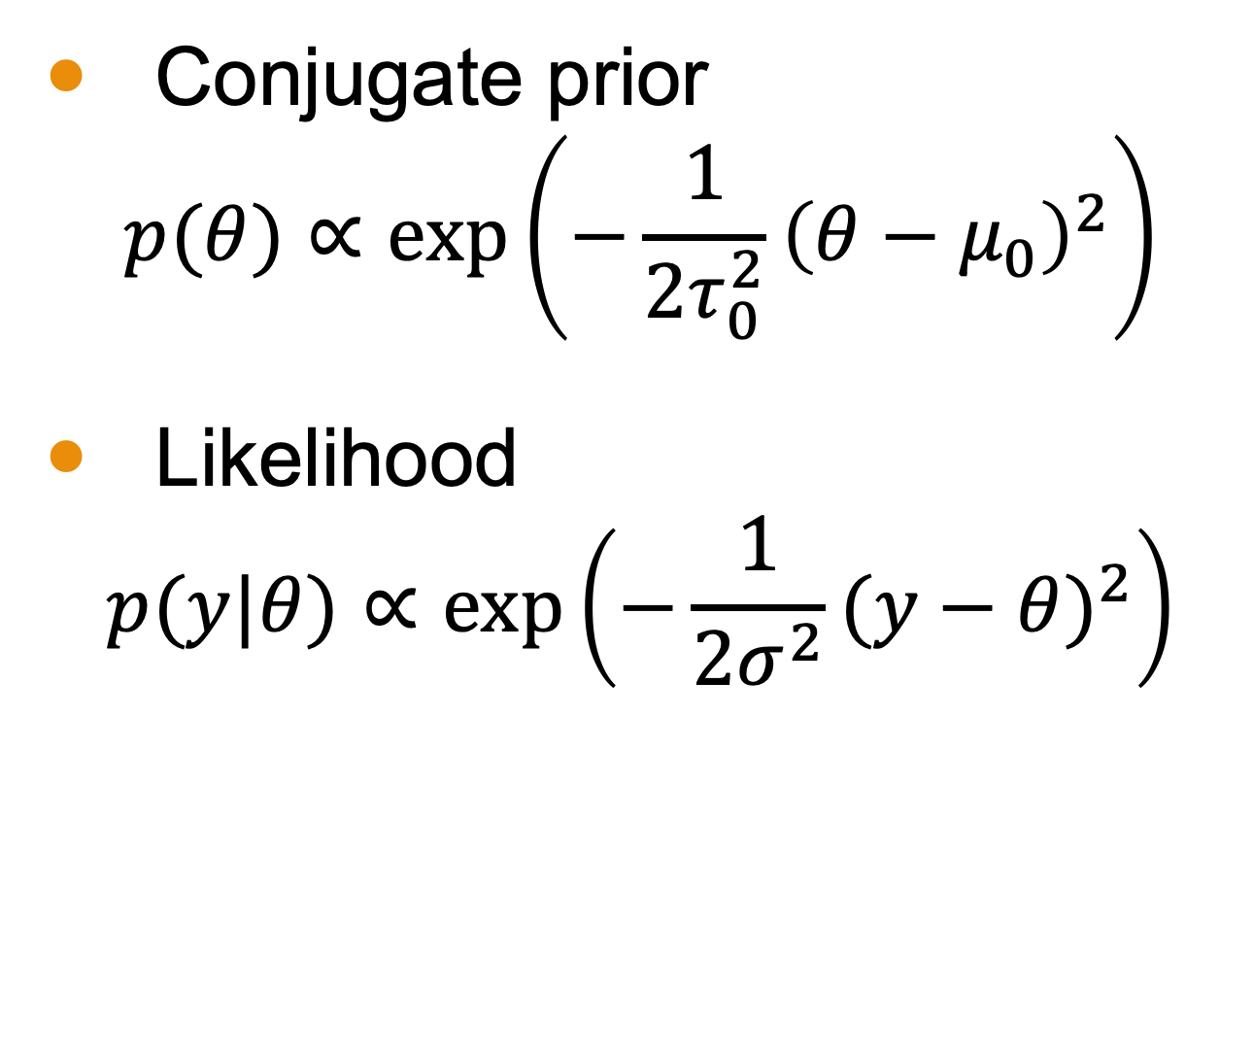
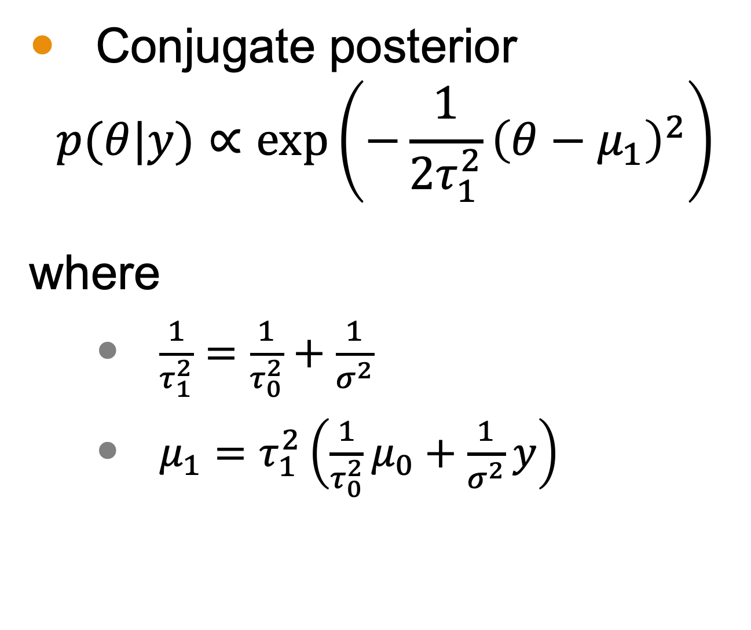
Conjugate Prior and Posterior Summary
Conjugate prior
$$p(θ)∝\text{exp}\left(−\frac{1}{2τ_{0}^{2}}{\left(θ−μ_{0}\right)}^{2}\right)$$
Likelihood
$$p(y|θ)∝\text{exp}\left(−\frac{1}{2σ^{2}}{(y−θ)}^{2}\right)$$
Conjugate posterior
$$p(θ|y)∝\text{exp}\left(−\frac{1}{2τ_{1}^{2}}{\left(θ−μ_{1}\right)}^{2}\right)$$
where
$\frac{1}{τ_{1}^{2}}=\frac{1}{τ_{0}^{2}}+\frac{1}{σ^{2}}$
$μ_{1}=$ $τ_{1}^{2}\left(\frac{1}{τ_{0}^{2}}μ_{0}+\frac{1}{σ^{2}}y\right)$
Notes:
The conjugate prior follows a normal distribution, despite starting from the more generic form of e to some quadratic.
The likelihood follows the familiar normal distribution.
And the resulting posterior follows a normal distribution
Where the mean and the variance are functions of the parameters of both the prior and sampling distribution.

Slide 10


Conjugate Prior and Posterior Summary
Conjugate prior
$$p(θ)∝\text{exp}\left(−\frac{1}{2τ_{0}^{2}}{\left(θ−μ_{0}\right)}^{2}\right)$$
Likelihood
$$p(y|θ)∝\text{exp}\left(−\frac{1}{2σ^{2}}{(y−θ)}^{2}\right)$$
Conjugate posterior
$$p(θ|y)∝\text{exp}\left(−\frac{1}{2τ_{1}^{2}}{\left(θ−μ_{1}\right)}^{2}\right)$$
where
$\frac{1}{τ_{1}^{2}}=\frac{1}{τ_{0}^{2}}+\frac{1}{σ^{2}}$
$μ_{1}=$ $τ_{1}^{2}\left(\frac{1}{τ_{0}^{2}}μ_{0}+\frac{1}{σ^{2}}y\right)$
Precision
Notes:
You may notice the prevalence of the inverse variance appearing in all of these equations, including the one that defines the variance of the posterior.
This is called precision

Slide 11
Side Note: Precision
The inverse variance is called precision.
The posterior precision equals the prior precision plus the data precision.
The posterior mean is expressed as a weighted average of the prior mean and the observed value, y, with the precisions serving as the weights.
Notes:
The inverse variance is called precision.
You’ll notice that the posterior precision equals the prior precision plus the data precision.
Moreover, the precision is relevant to the mean. The posterior mean is expressed as a weighted average of the prior mean and the observed value, y, with the precisions serving as the weights.
Precision turns out to be a fundamental concept in statistical modeling because it simplifies mathematical derivations, enhances numerical stability, and facilitates the combination of information from multiple sources. You will see this again in many derivations throughout the class.

Slide 12
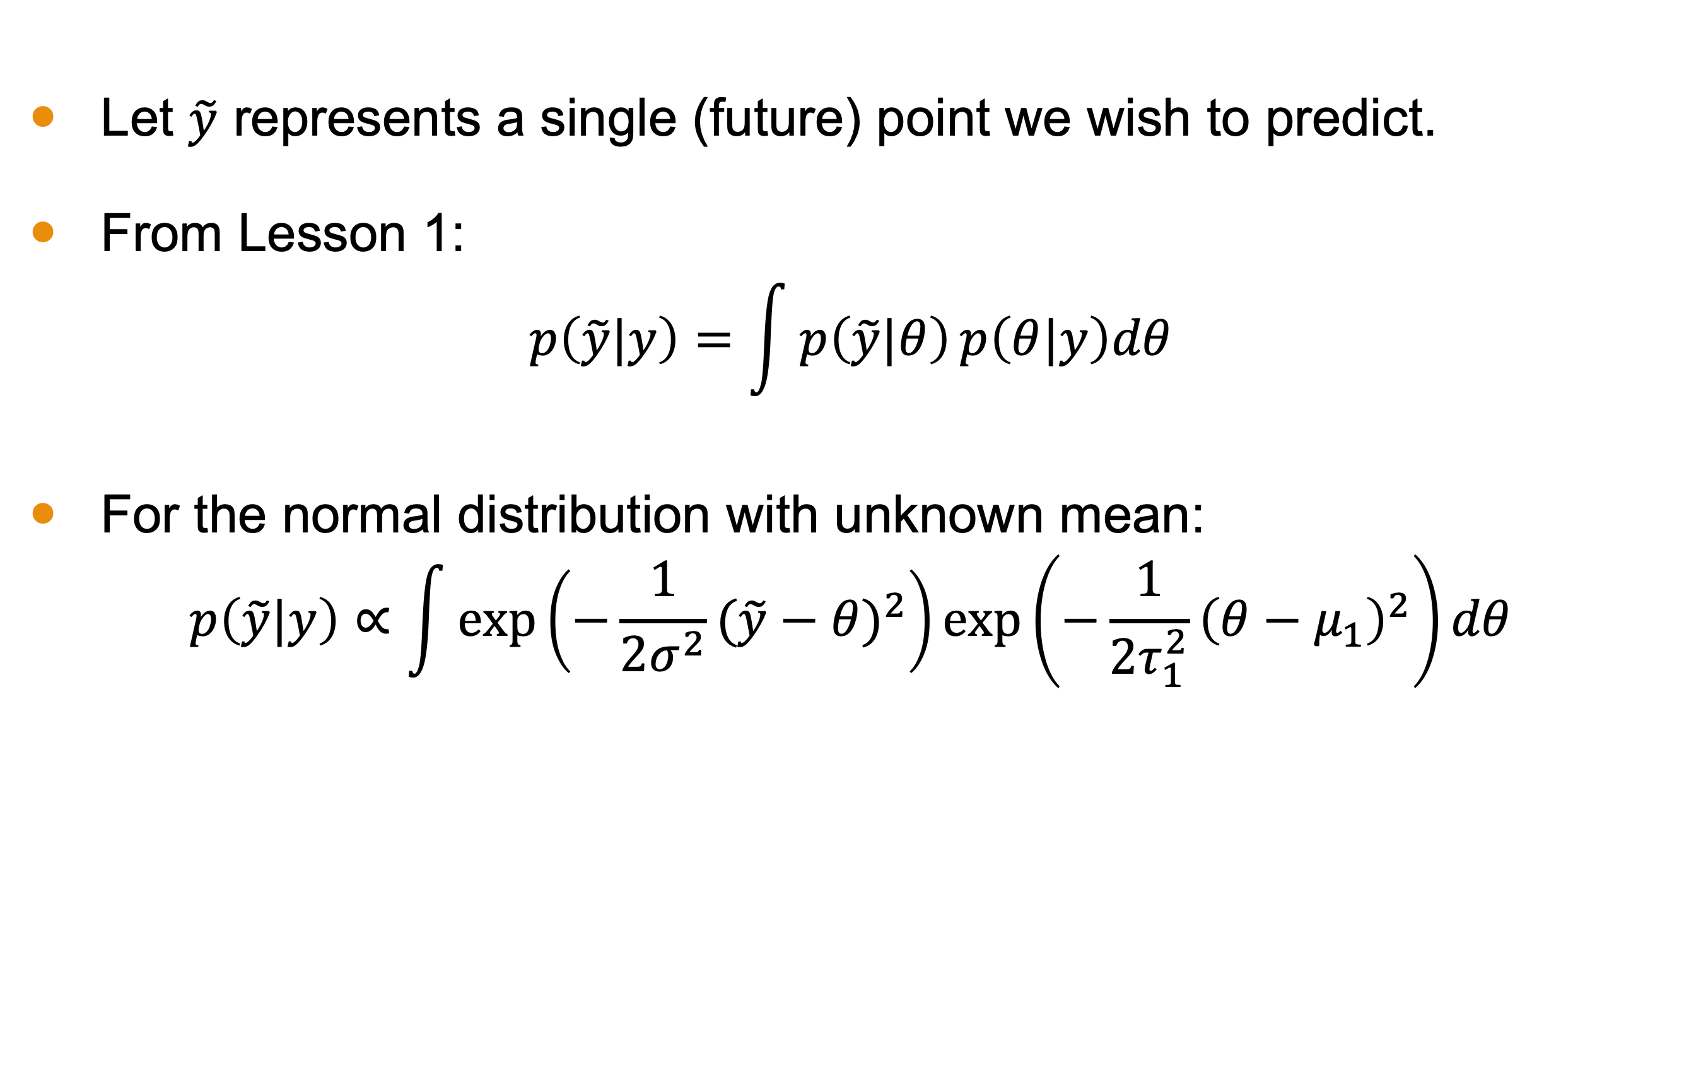
Posterior Predictive Distribution
Let $\tilde{y}$ represents a single (future) point we wish to predict.
From Lesson 1:
$$p\left(\tilde{y}|y\right)=\int{p\left(\tilde{y}|θ\right)}p\left(θ|y\right)dθ$$
For the normal distribution with unknown mean:
$$p\left(\tilde{y}|y\right)∝\int{\text{exp}\left(−\frac{1}{2σ^{2}}{(\tilde{y}−θ)}^{2}\right)}\text{exp}\left(−\frac{1}{2τ_{1}^{2}}{\left(θ−μ_{1}\right)}^{2}\right)dθ$$
Notes:
The primary deliverable of any activity in Bayesian inference is the distribution itself. Such a distribution is used for prediction.
For predicting a single future data point $\tilde{y}$
We can reference the equation WE SAW from lesson 1: $p\left(\tilde{y}|y\right)=\int{p\left(\tilde{y}|θ\right)}p\left(θ|y\right)dθ$
Which scales the computation according to the posterior likelihood of all potential values of our hidden parameter$θ$.
For a normal distribution with an unknown mean, this integral can be expanded to be what you see here.
Now we show that this simplified to a normal distribution for y-tilde.

Slide 13
(board example inserted here)
Notes:
Simplifying to find the mean and variance of p(y~|y)

Slide 14
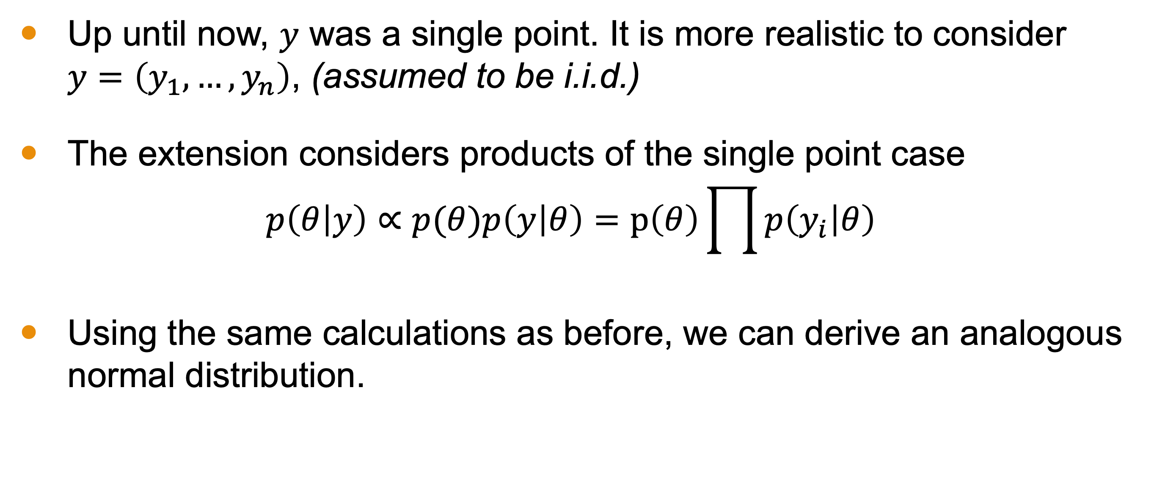
Normal Model with Multiple Observations
Up until now, $y$ was a single point. It is more realistic to consider $y=\left(y_{1},…,y_{n}\right)$, (assumed to be i.i.d.)
The extension considers products of the single point case
$$p\left(θ | y\right)∝p(θ)p\left(y | θ\right)=p\left(θ\right)\prod{p\left(y_{i} | θ\right)}$$
Using the same calculations as before, we can derive an analogous normal distribution.
Notes:
Up until now, $y$ was a single point. It is more realistic to consider $y=\left(y_{1},…,y_{n}\right)$, (assumed to be i.i.d.)
The extension considers products of the single point case
$$p\left(θ | y\right)∝p(θ)p\left(y | θ\right)=p\left(θ\right)\prod{p\left(y_{i} | θ\right)}$$
Using the same calculations as before, we can derive an analogous normal distribution, relying on the sample mean which is a sufficient statistics in this context.

Slide 15
(board example inserted here)
Notes:
Multiple points derivation

Slide 16
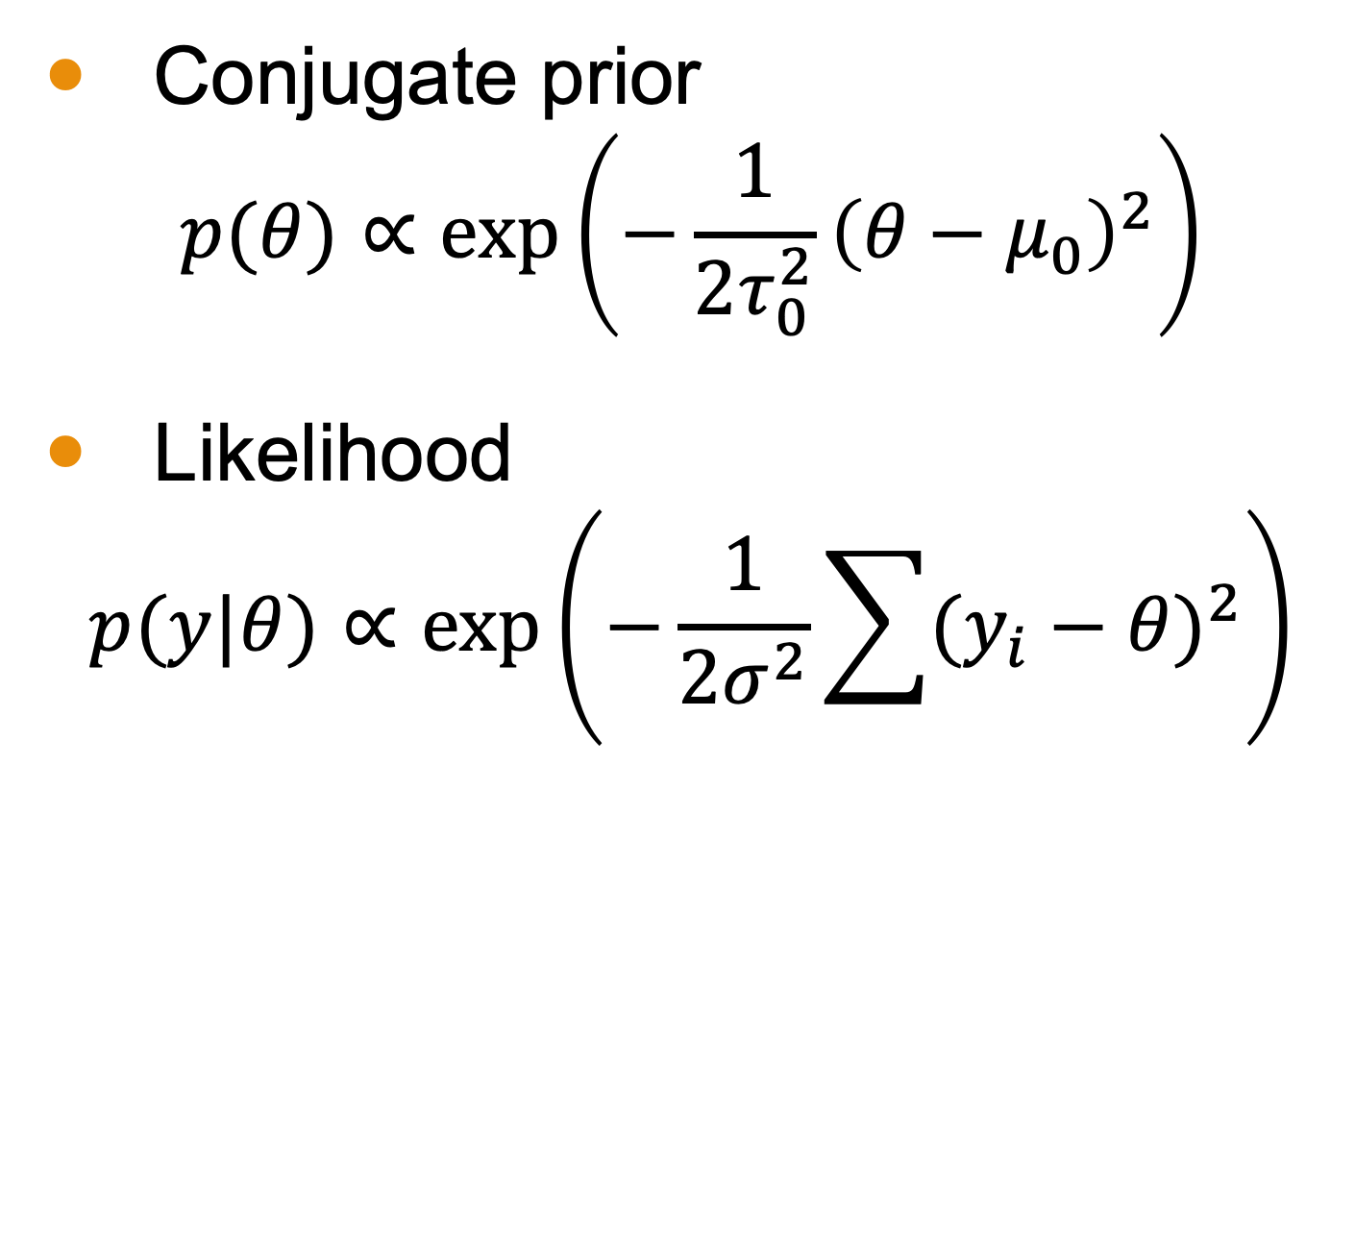
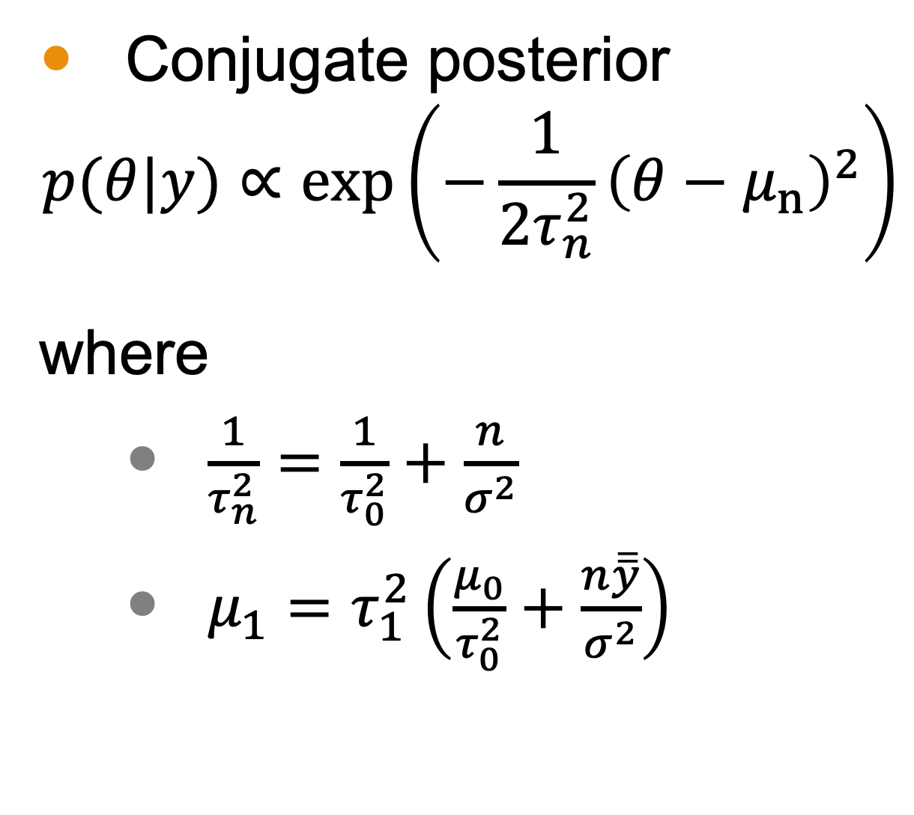
Conjugate Prior and Posterior Summary
Conjugate prior
$$p(θ)∝\text{exp}\left(−\frac{1}{2τ_{0}^{2}}{\left(θ−μ_{0}\right)}^{2}\right)$$
Likelihood
$$p(y|θ)∝\text{exp}\left(−\frac{1}{2σ^{2}}\sum{{(y_{i}−θ)}^{2}}\right)$$
Conjugate posterior
$$p(θ|y)∝\text{exp}\left(−\frac{1}{2τ_{n}^{2}}{\left(θ−μ_{n}\right)}^{2}\right)$$
where
$\frac{1}{τ_{n}^{2}}=\frac{1}{τ_{0}^{2}}+\frac{n}{σ^{2}}$
$μ_{1}=$ $τ_{1}^{2}\left(\frac{μ_{0}}{τ_{0}^{2}}+\frac{n\overline{\overline{y}}}{σ^{2}}\right)$
Notes:
The conjugate prior follows a normal distribution for the same reasons as the single point case.
The likelihood follows the familiar normal distribution, but with a summation to reflect the many data points collected.
And the resulting posterior follows a normal distribution as well.
Where the mean and the variance are functions of the parameters of both the prior and sampling distribution as well as the sample size and sample mean

Slide 17
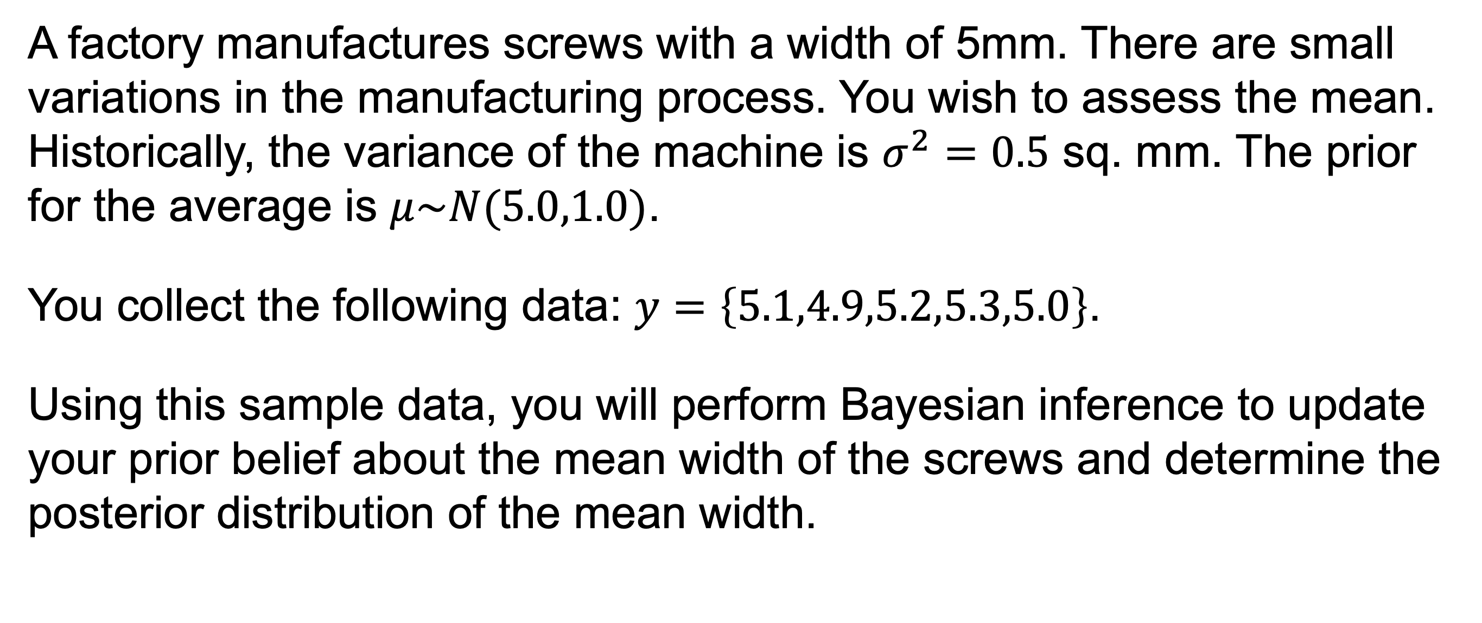
Example with Multiple Points
A factory manufactures screws with a width of 5mm. There are small variations in the manufacturing process. You wish to assess the mean. Historically, the variance of the machine is $σ^{2}=0.5$ sq. mm. The prior for the average is $μ\sim N(5.0,1.0)$.
You collect the following data: $y=\left\{5.1,4.9,5.2,5.3,5.0\right\}$.
Using this sample data, you will perform Bayesian inference to update your prior belief about the mean width of the screws and determine the posterior distribution of the mean width.

Slide 18
(board example inserted here)
Notes:
example

Slide 19
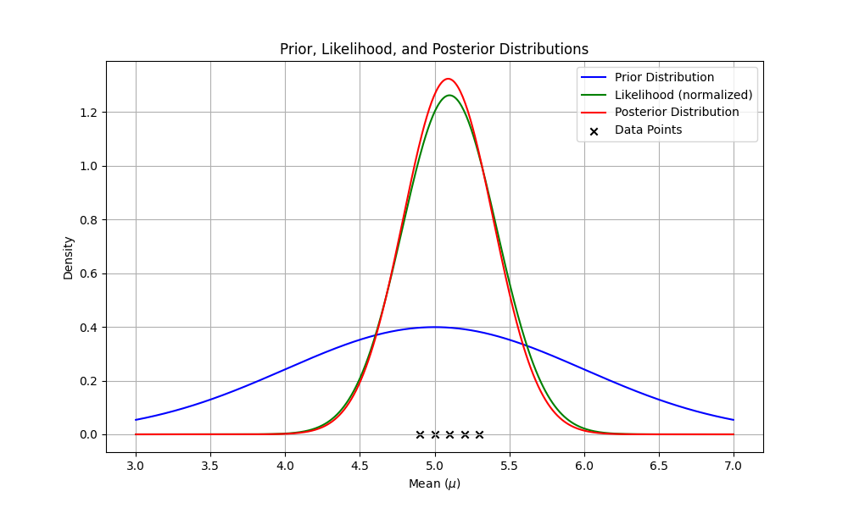
Example Distributions
Notes:
Here are the resulting distribution. Notice that our variance shrinks with our posterior and our peak is slightly higher.
This is a sensible result in Bayesian statistics because it illustrates that we grow more certain of our findings in the face of more data.,

Slide 20
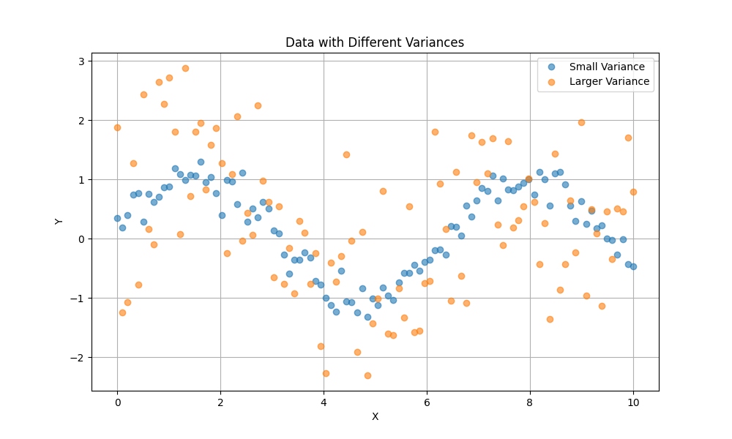
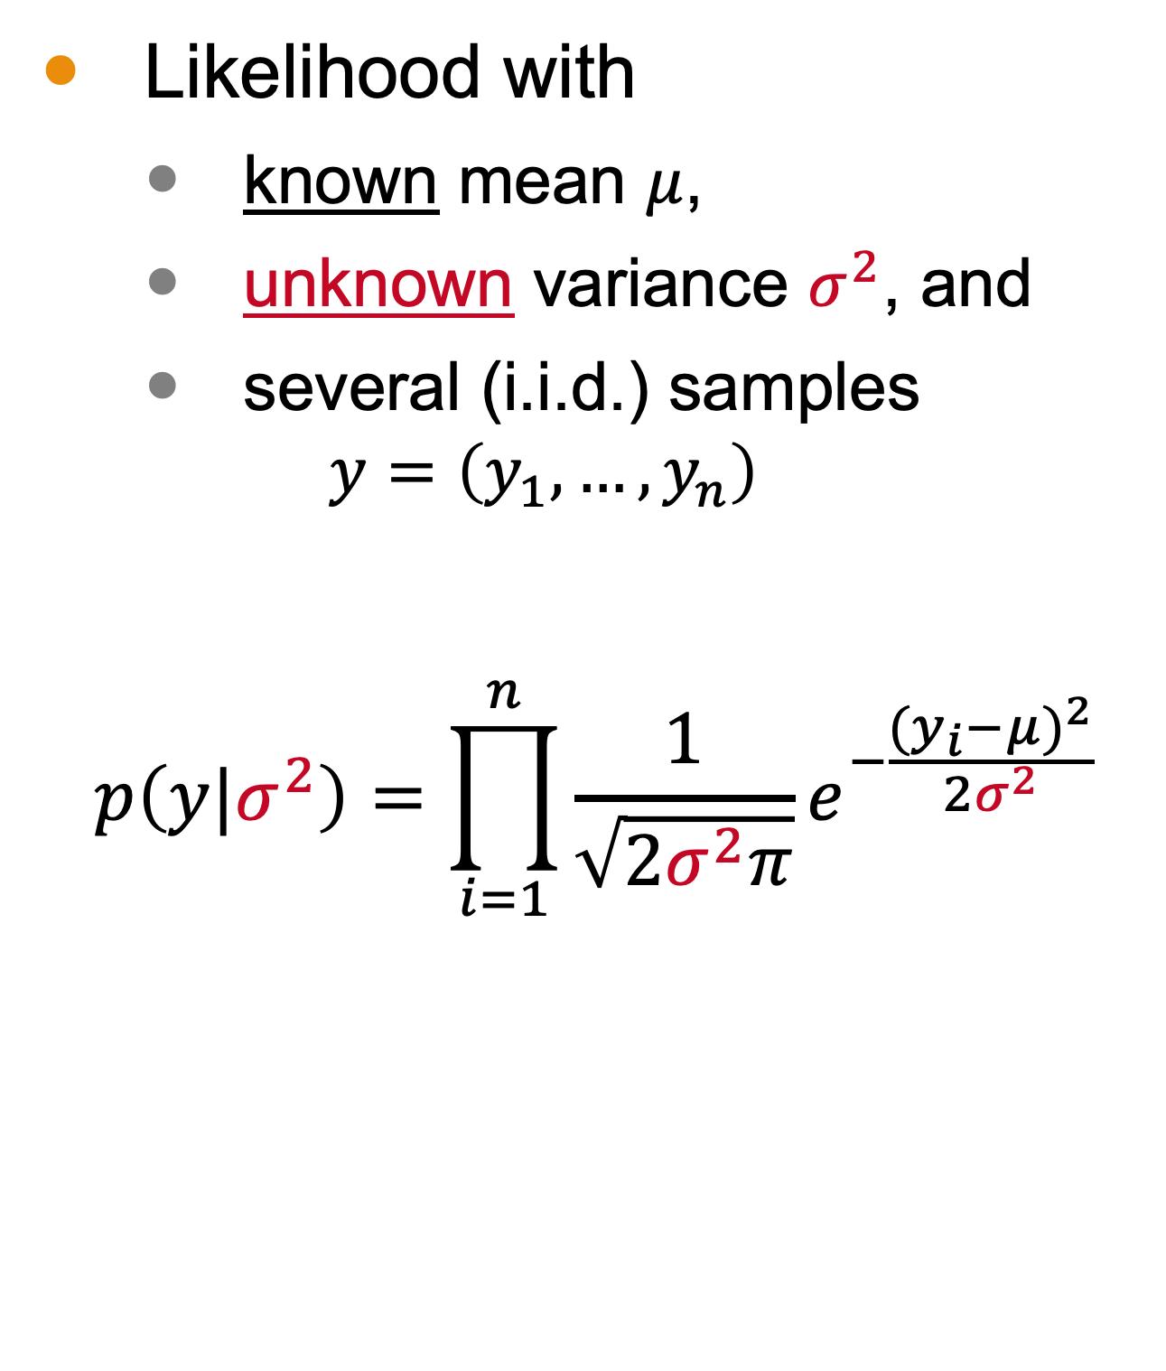
Normal Distribution with Unknown Variance
Likelihood with
known mean $μ$,
unknown variance $σ^{2}$, and
several (i.i.d.) samples $y=\left(y_{1},…,y_{n}\right)$
$$p\left(y|σ^{2}\right)=\prod_{i=1}^{n}{\frac{1}{\sqrt{2σ^{2}π}}e^{−\frac{{(y_{i}−μ)}^{2}}{2σ^{2}}}}$$
Notes:
Variance is a measure of the spread of data. In the image generated for this slide, we see two datasets with the same trends but different variance. The orange dataset has a much larger variance than the blue one.
Here, we will continue looking at the normal distribution but will consider the case when we know the mean but do not know the variance. We assume our sample is iid. Note that we have to consider several datapoints because it is not possible to estimate the variance from a single point.
While it may be confusion, the unknown parameter now is this sigma^2. In my board work, I will continue to use theta for the mean even though it is not the unknown parameter. I do this only to stay more consistent with the textbook.

Slide 21
(board example inserted here)
Notes:
Simplify the likelihood, compute the conjugate prior, and find the posterior.

Slide 22
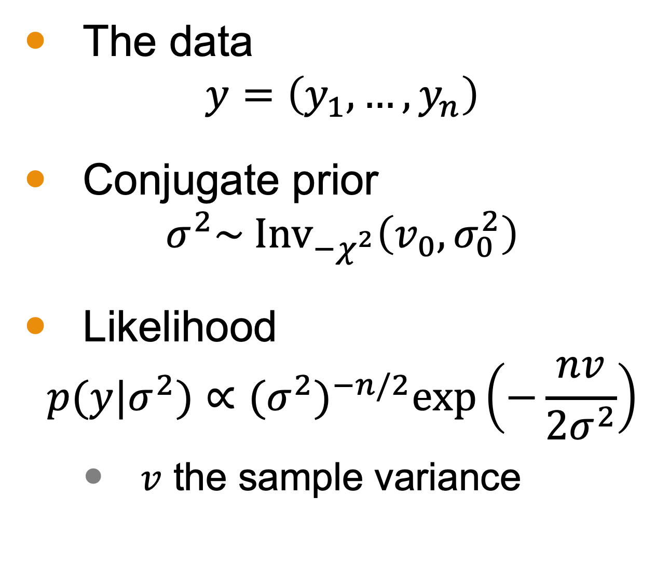
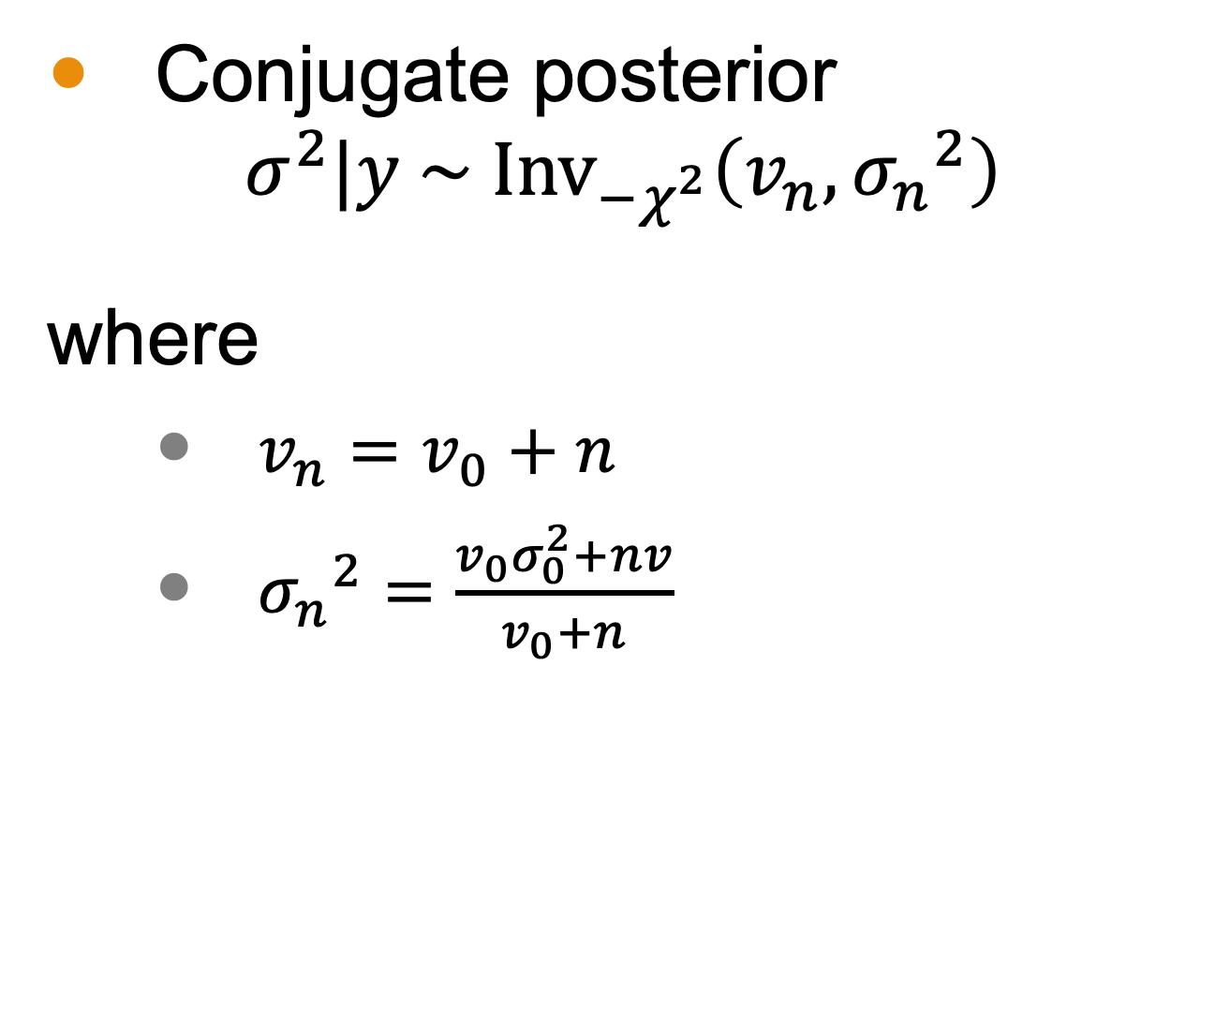
Conjugate Prior and Posterior Summary
The data
$$y=\left(y_{1},…,y_{n}\right)$$
Conjugate prior
$$σ^{2}\sim {\text{Inv}}_{−χ^{2}}\left(v_{0},σ_{0}^{2}\right)$$
Likelihood
$$p(y|σ^{2})∝{(σ^{2})}^{−n/2}\text{exp}\left(−\frac{nv}{2σ^{2}}\right)$$
$v$ the sample variance
Conjugate posterior
$$σ^{2}|y \sim {\text{Inv}}_{−χ^{2}}\left(v_{n}, {σ_{n}}^{2}\right)$$
where
$v_{n}=v_{0}+n$
${σ_{n}}^{2}=\frac{v_{0}σ_{0}^{2}+nv}{v_{0}+n}$
Notes:
We must have data consisting of several data points.
Our conjugate prior follows a scaled inverse chi squared distribution with some degrees of freedom and scale.
The likelihood follows our normal distribution, where v is the sample variance.
The posterior then also follow is a scaled inverse chi squared distribution
Where the degrees of freedom are dependent on the prior’s degree’s of freedom and the sample size and where the variance depends on the prior distributions parameters as well as the size of the sample and its sample variance.

Slide 23

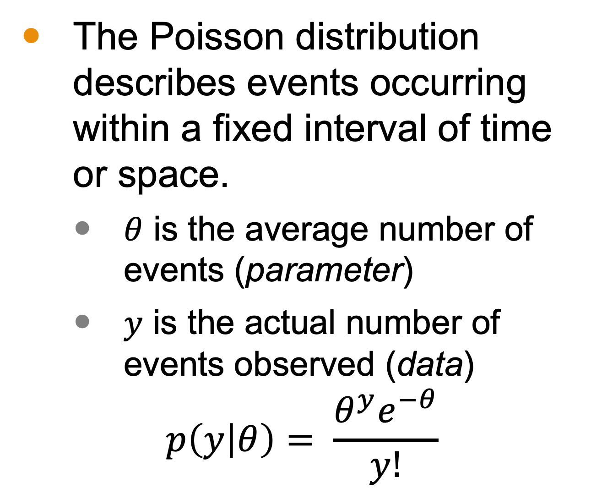
Poisson Distributions
The Poisson distribution describes events occurring within a fixed interval of time or space.
$θ$ is the average number of events (parameter)
$y$ is the actual number of events observed (data)
$$p\left(y | θ\right)= \frac{θ^{y}e^{−θ}}{y!}$$
Microsoft Stock Images
Notes:
The Poisson distribution describes events occurring within a fixed interval of time or space. When I studied this in college, my professor used the metaphor of chocolate chips in a cookie. But any kind of identification of points within a unit ”area” (regardless of dimension holds. In the image, we could use a poisson distribution, for example, to discuss the frequency of red sprinkings within each square inch.
The parameter is the average number of events, such as the average number of sprinkles per square ince.
and y is the actual number of events observed.
The likelihood function follows this formula.

Slide 24
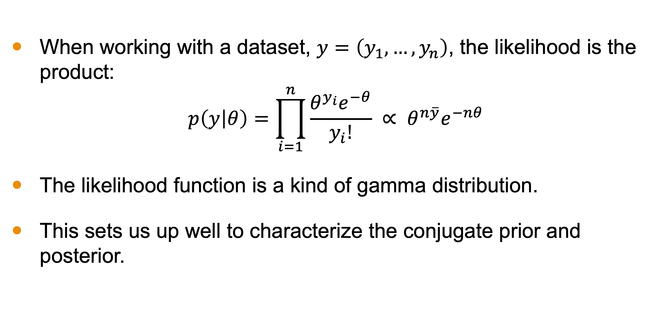
Poisson Likelihood
When working with a dataset, $y=\left(y_{1},…,y_{n}\right)$, the likelihood is the product:
$$p\left(y | θ\right)=\prod_{i=1}^{n}{\frac{θ^{y_{i}}e^{−θ}}{y_{i}!}} ∝ θ^{n\overline{y}}e^{−nθ}$$
The likelihood function is a kind of gamma distribution.
This sets us up well to characterize the conjugate prior and posterior.
Notes:
For a dataset, the Poisson likelihood is the product of individual Poisson probabilities.
The likelihood function resembles a gamma distribution,
which sets us up to characterize the conjugate prior and posterior.

Slide 25
(board example inserted here)
Notes:
Simplify the likelihood, compute the conjugate prior, and find the posterior for the Poisson distribution

Slide 26
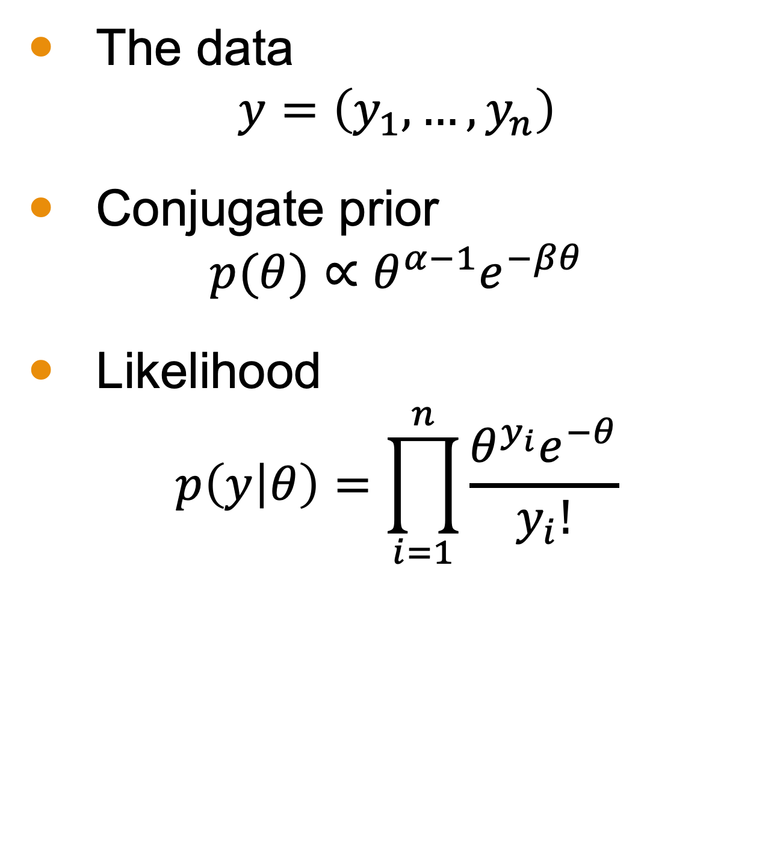
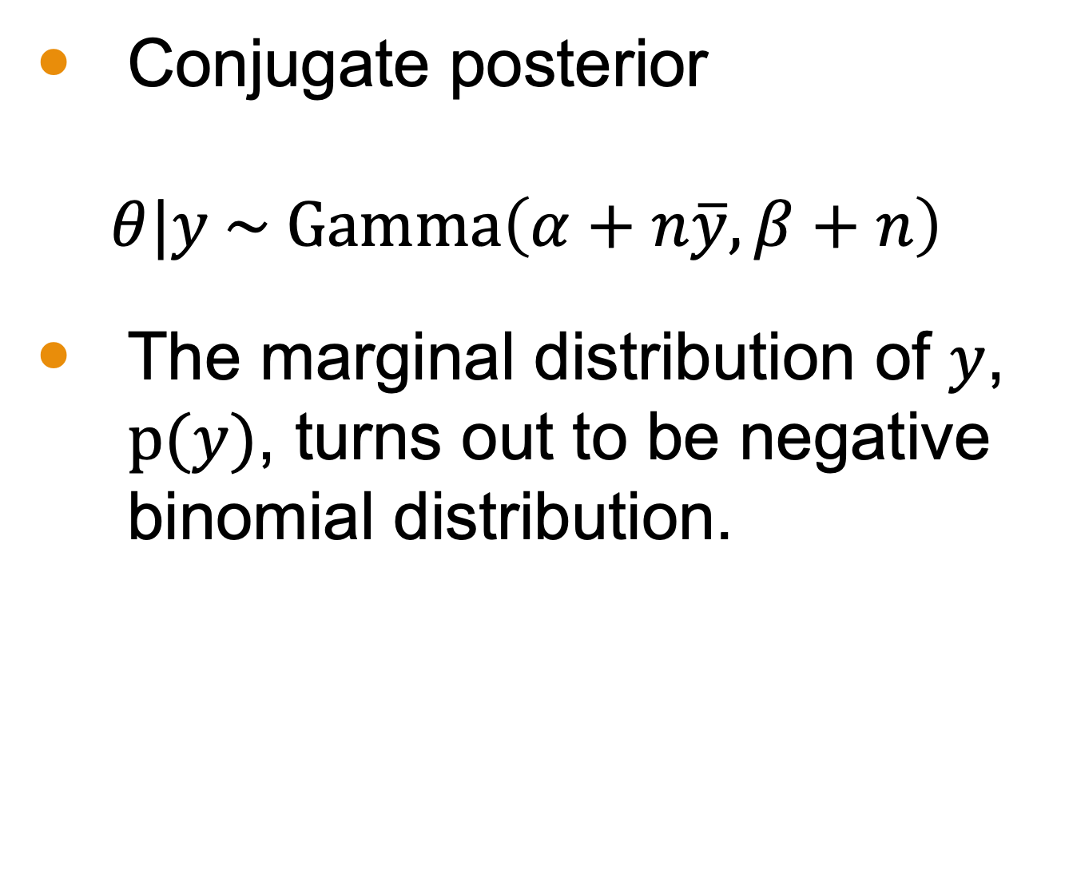
Conjugate Prior and Posterior Summary
The data
$$y=\left(y_{1},…,y_{n}\right)$$
Conjugate prior
$$p(θ)∝θ^{α−1}e^{−βθ}$$
Likelihood
$$p\left(y | θ\right)=\prod_{i=1}^{n}{\frac{θ^{y_{i}}e^{−θ}}{y_{i}!}}$$
Conjugate posterior
$$θ|y \sim \text{Gamma}\left(α+n\overline{y},β+n\right)$$
The marginal distribution of $y$, $p(y)$, turns out to be negative binomial distribution.
Notes:
The conjugate prior for the Poisson distribution is the gamma distribution. The posterior distribution can be derived and is also a gamma distribution. This allows for straightforward updating of the parameter theta.

Slide 27
(board example inserted here)
Notes:
asthma example

Slide 28

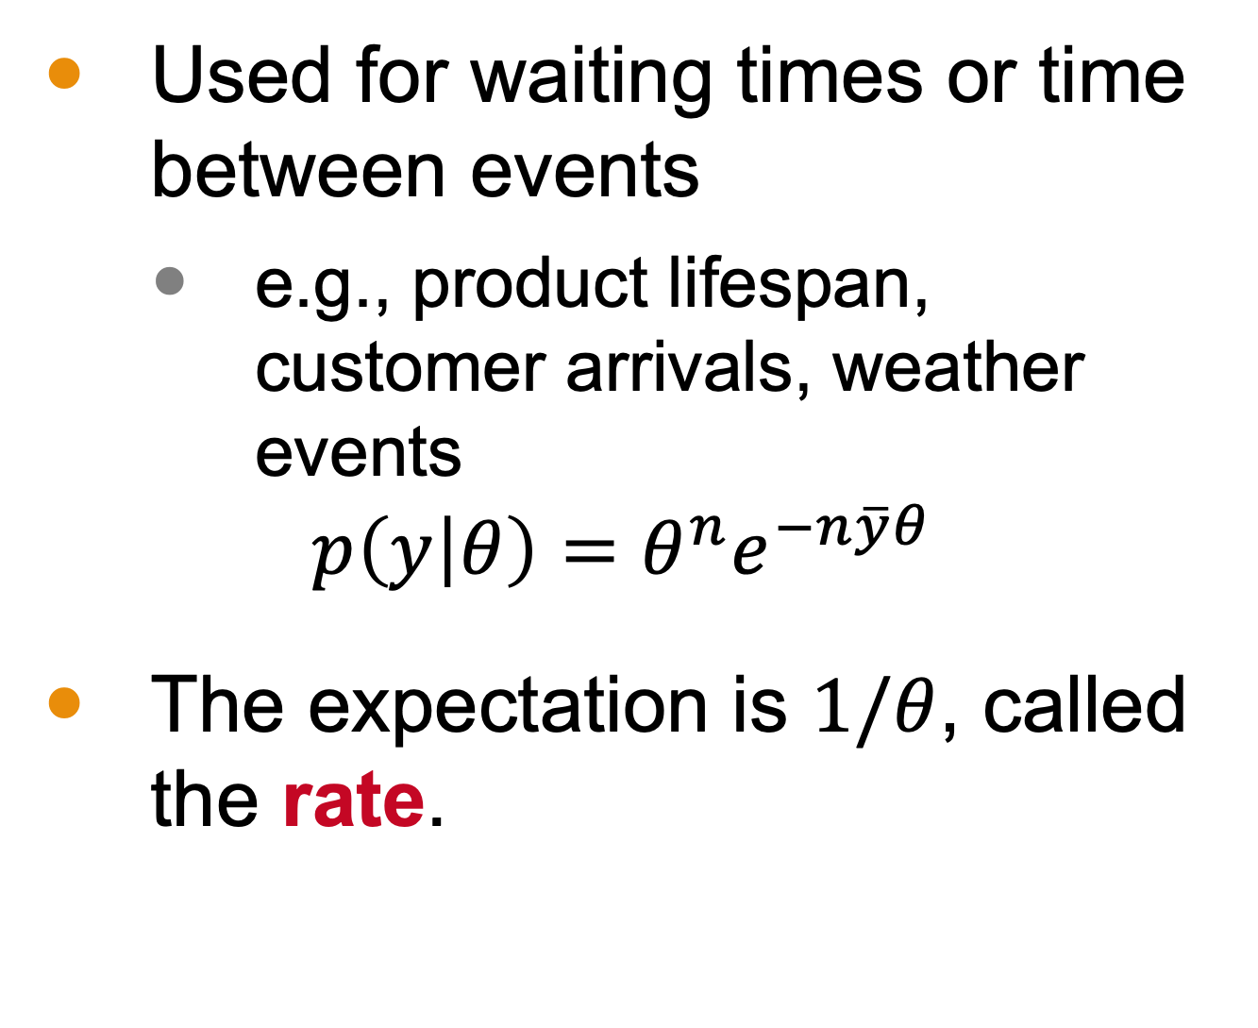
Exponential Likelihood
Used for waiting times or time between events
e.g., product lifespan, customer arrivals, weather events
$$p\left(y | θ\right)=θ^{n}e^{−n\overline{y}θ}$$
The expectation is $1/θ$, called the rate.
iStock-1051006028, Credit: andresr
Notes:
The exponential distribution is used for modeling waiting times or time between events.
Examples are any reflection of spaced out events such as customer arrivals, as we see in the image.
The rate parameter theta is the expectation. The likelihood of the exponential distribution is a gamma distribution with shape parameter equal to the number of observations and rate parameter equal to the total waiting time.

Slide 29
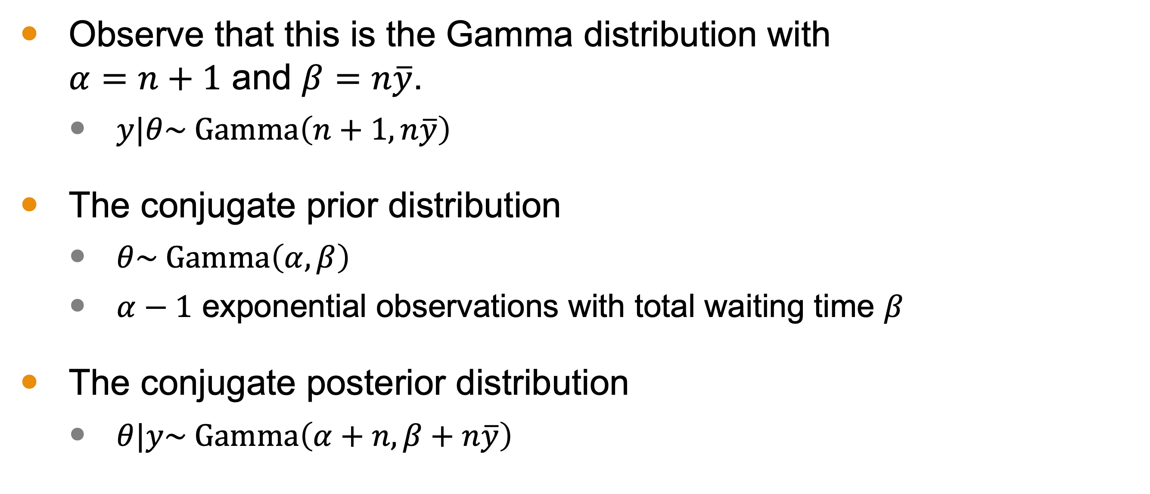
Exponential Likelihood
Observe that this is the Gamma distribution with $α=n+1$ and $β=n\overline{y}$.
$y|θ\sim \text{Gamma}\left(n+1,n\overline{y}\right)$
The conjugate prior distribution
$θ\sim \text{Gamma}\left(α,β\right)$
$α−1$ exponential observations with total waiting time $β$
The conjugate posterior distribution
$θ|y\sim \text{Gamma}\left(α+n,β+n\overline{y}\right)$
Notes:
The conjugate prior for the exponential distribution is also a gamma distribution. The posterior distribution can be computed similarly to the Poisson case, providing an updated rate parameter.

Slide 30
Next Time
Multiparameter models
Notes:
Next time, we will explore multi-parameter models, expanding on the concepts learned in single-parameter models and applying them to more complex scenarios.

